Slide 1
Time Series Analysis
Basics of Time Series Analysis
Nicoleta Serban, Ph.D.
Associate Professor
Stewart School of Industrial and Systems Engineering
Linear Processes & Prediction

Slide 2
About this lesson

Slide 3
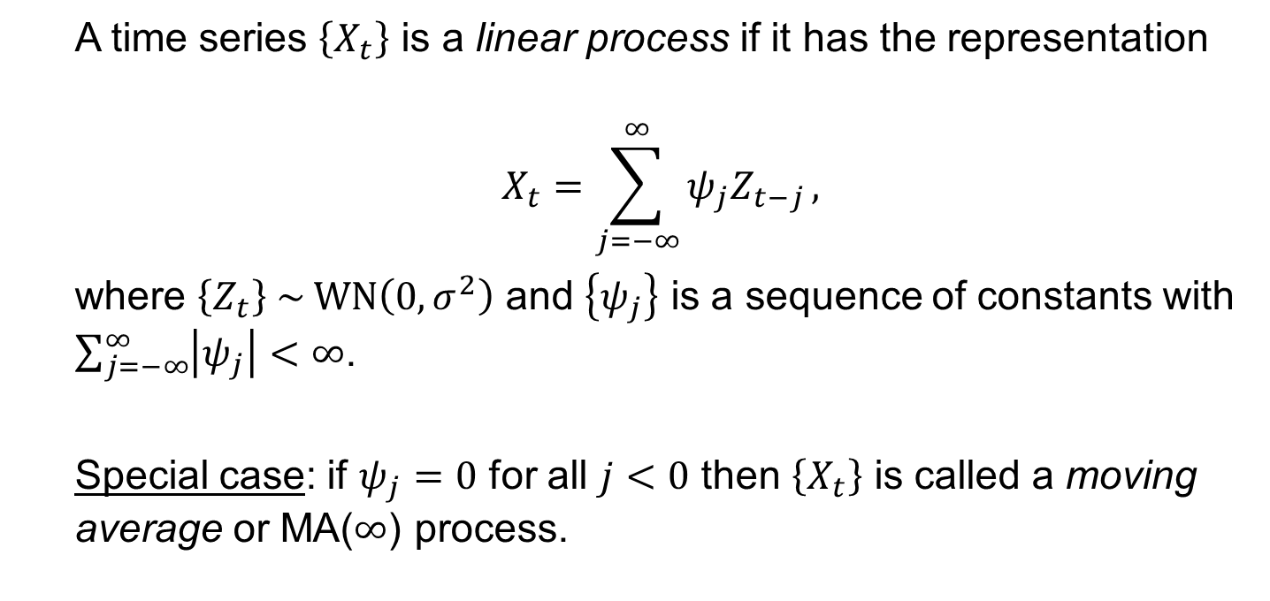
Linear Processes
A time series $\left\{X_{t}\right\}$ is a linear process if it has the representation
$$X_{t}=\sum_{j=−∞}^{∞}{ψ_{j}Z_{t−j}},$$
where $\left\{Z_{t}\right\} \sim \text{WN}\left(0, σ^{2}\right)$ and $\left\{ψ_{j}\right\}$ is a sequence of constants with $\sum_{j=−∞}^{∞}{\left|ψ_{j}\right|<∞}$.
Special case: if $ψ_{j}=0$ for all $j<0$ then $\left\{X_{t}\right\}$ is called a moving average or MA($∞$) process.

Slide 4
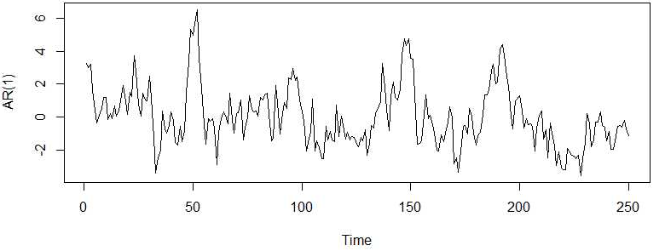
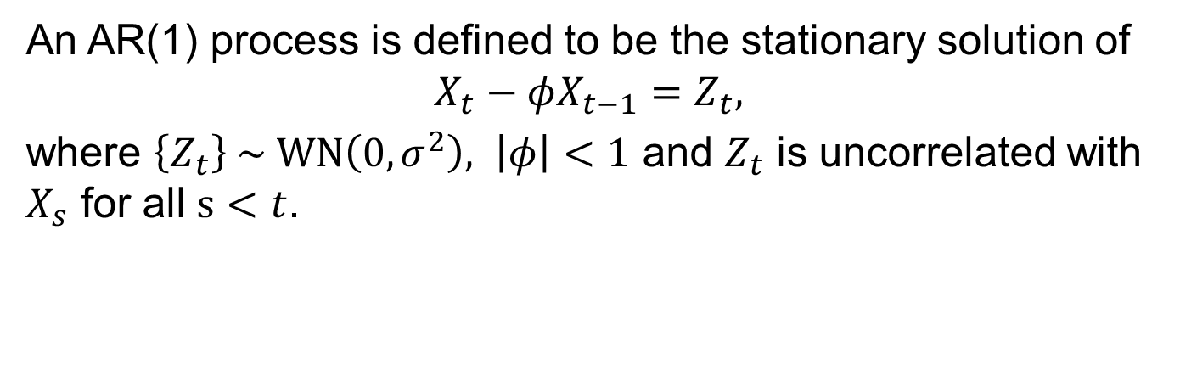
Linear Processes: Example
An AR(1) process is defined to be the stationary solution of
$$X_{t}−φX_{t−1}=Z_{t},$$
where $\left\{Z_{t}\right\} \sim \text{WN}\left(0, σ^{2}\right), \left|φ\right|<1$ and $Z_{t}$ is uncorrelated with $X_{s}$ for all $s<t$.

Slide 5
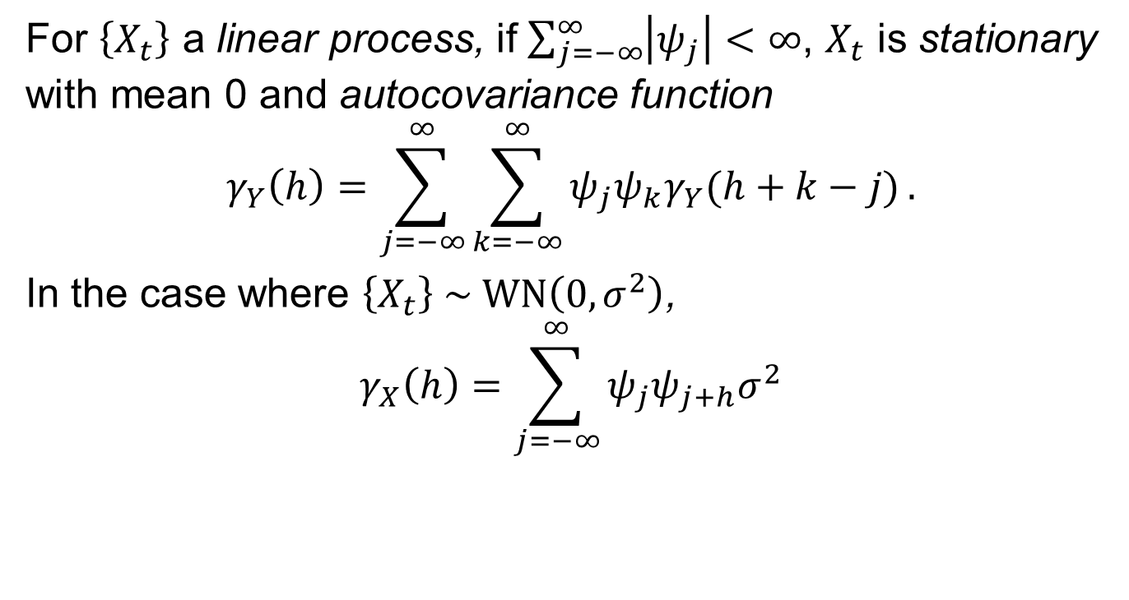
Linear Processes: Autocovariance
For $\left\{X_{t}\right\}$ a linear process, if $\sum_{j=−∞}^{∞}{\left|ψ_{j}\right|<∞}$, $X_{t}$ is stationary with mean 0 and autocovariance function
$$γ_{Y}\left(h\right)=\sum_{j=−∞}^{∞}{\sum_{k=−∞}^{∞}{ψ_{j}ψ_{k}γ_{Y}(h+k−j)}}.$$
In the case where $\left\{X_{t}\right\} \sim \text{WN}\left(0, σ^{2}\right)$,
$$γ_{X}\left(h\right)=\sum_{j=−∞}^{∞}{ψ_{j}ψ_{j+h}σ^{2}}$$

Slide 6
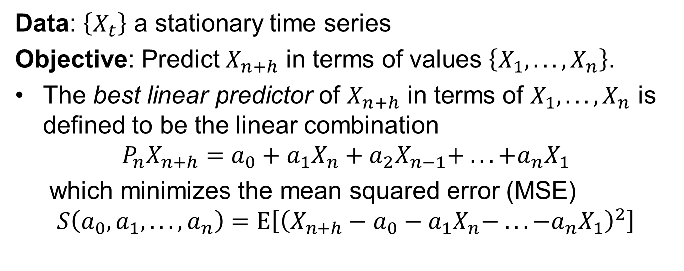
Prediction for a Stationary Time Series
Data: $\left\{X_{t}\right\}$ a stationary time series
Objective: Predict $X_{n+h}$ in terms of values $\left\{X_{1}, .. .,X_{n}\right\}$.
The best linear predictor of $X_{n+h}$ in terms of $X_{1}, .. .,X_{n}$ is defined to be the linear combination
$$P_{n}X_{n+h}=a_{0}+a_{1}X_{n}+a_{2}X_{n−1}+ .. . +a_{n}X_{1}$$
which minimizes the mean squared error (MSE)
$$S\left(a_{0}, a_{1}, .. ., a_{n}\right)=Ε\left[{\left(X_{n+h}−a_{0}−a_{1}X_{n}− .. . −a_{n}X_{1}\right)}^{2}\right]$$

Slide 7
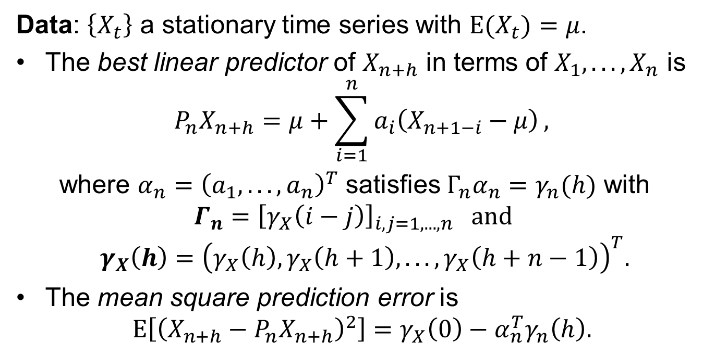
Best Linear Predictor
Data: $\left\{X_{t}\right\}$ a stationary time series with $Ε{(X}_{t})=μ$.
The best linear predictor of $X_{n+h}$ in terms of $X_{1}, .. .,X_{n}$ is
$$P_{n}X_{n+h}=μ+\sum_{i=1}^{n}{a_{i}\left(X_{n+1−i}−μ\right)},$$
where $α_{n}={\left(a_{1}, .. ., a_{n}\right)}^{T}$ satisfies $Γ_{n}α_{n}=γ_{n}(h)$ with
$$Γ_{n}={\left[γ_{X}\left(i−j\right)\right]}_{i, j=1, .. . , n} \text{and}$$
$$γ_{X}\left(h\right)={\left(γ_{X}\left(h\right),γ_{X}\left(h+1\right), .. .,γ_{X}\left(h+n−1\right)\right)}^{T}.$$
The mean square prediction error is
$$Ε\left[{\left(X_{n+h}−P_{n}X_{n+h}\right)}^{2}\right]=γ_{X}\left(0\right)−α_{n}^{T}γ_{n}\left(h\right).$$

Slide 8
Best Linear Predictor (cont’d)
If $Γ_{n}$ is non-singular, then
$P_{n}X_{n+1}=α_{n}^{T}{\left(X_{n}, X_{n−1}, .. ., X_{1}\right)}^{T},$where $α_{n}= Γ_{n}^{−1}γ_{n}\left(1\right).$
The corresponding mean-squared prediction error is
$$v_{n}=γ_{X}\left(0\right)−α_{n}^{T}γ_{n}\left(1\right).$$
Problem: When $n$ is large, $Γ_{n}^{−1}$ can be a nuisance to compute.

Slide 9
The Durbin-Levinson Algorithm
Let $α_{n}=\left(a_{n1}, .. ., a_{nn}\right)$ be the solution to $α_{n}= Γ_{n}^{−1}γ_{n}\left(1\right)$. Then the coefficients $a_{n1}, .. ., a_{nn}$ can be computed recursively by
$$a_{nn}=\frac{1}{v_{n−1}}\left[γ_{X}\left(n\right)−\sum_{j=1}^{n−1}{a_{n−1, j}γ_{X}(n−j)}\right],$$
$$\left[\begin{matrix}a_{n, 1} \\ ⋮ \\ a_{n, n−1}\end{matrix}\right]=\left[\begin{matrix}a_{n−1, 1} \\ ⋮ \\ a_{n−1, n−1}\end{matrix}\right]−a_{nn}\left[\begin{matrix}a_{n−1, n−1} \\ ⋮ \\ a_{n−1, 1}\end{matrix}\right],$$
and
$$v_{n}=v_{n−1}\left(1−a_{nn}^{2}\right),$$
where $a_{11}={γ_{X}(1)}/{γ_{X}(0)}$ and $v_{0}=γ_{X}(0)$.

Slide 10
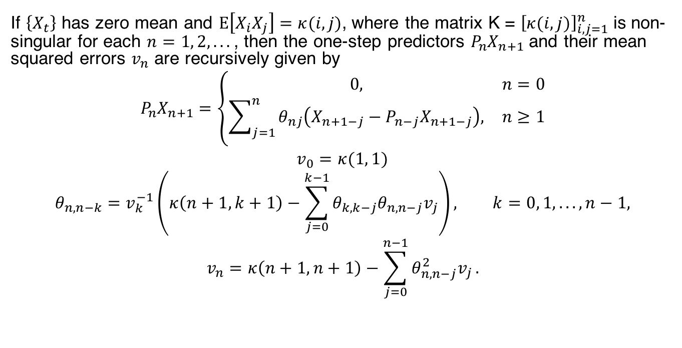
The Innovations Algorithm
If $\left\{X_{t}\right\}$ has zero mean and $Ε\left[X_{i}X_{j}\right]=κ(i, j)$, where the matrix K = ${\left[κ(i, j)\right]}_{i, j=1}^{n}$ is non-singular for each $n=1, 2, .. .$, then the one-step predictors $P_{n}X_{n+1}$ and their mean squared errors $v_{n}$ are recursively given by
$$P_{n}X_{n+1}=\left\{\begin{matrix}0, & n=0 \\ \sum_{j=1}^{n}{θ_{nj}\left(X_{n+1−j}−P_{n−j}X_{n+1−j}\right),} & n≥1\end{matrix}\right.$$
$$v_{0}=κ(1, 1)$$
$$θ_{n, n−k}=v_{k}^{−1}\left(κ\left(n+1, k+1\right)−\sum_{j=0}^{k−1}{θ_{k, k−j}θ_{n, n−j}v_{j}}\right), k=0, 1, .. ., n−1,$$
$$v_{n}=κ\left(n+1, n+1\right)−\sum_{j=0}^{n−1}{θ_{n, n−j}^{2}v_{j}}.$$

Slide 11
Summary

